Slide 1


Sales Retail analysis Ashiat Adeogun

Slide 2
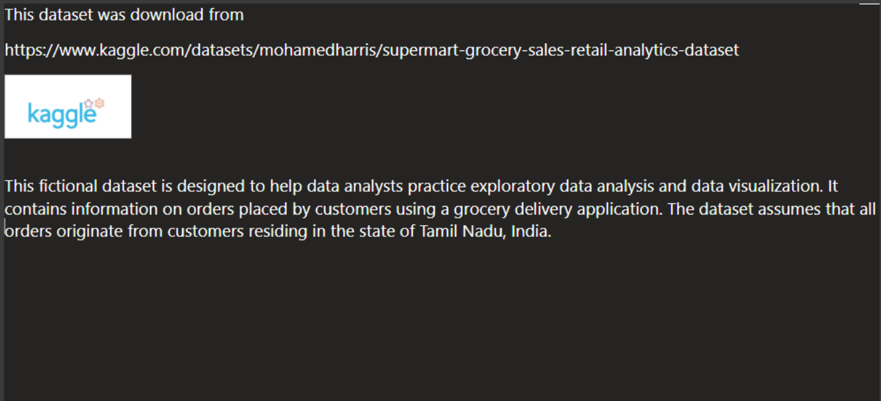

Slide 3
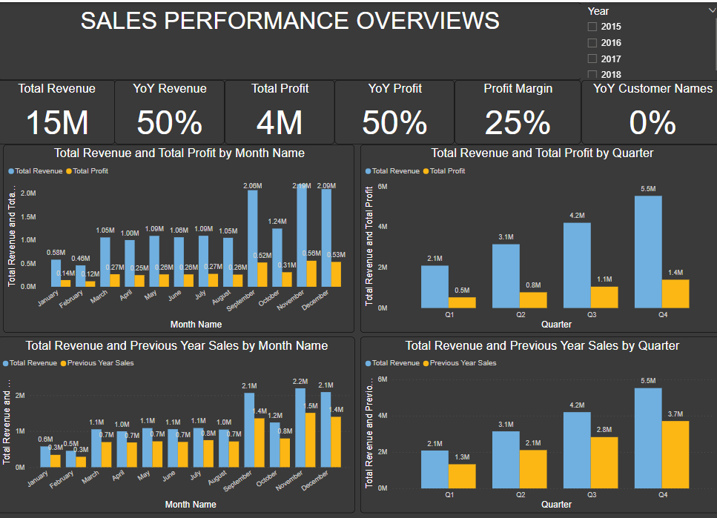
Key Insights Summary:
The business generated $15M in revenue with a profit of $4M.
YoY Revenue growth is 50%, indicating significant improvement.
Q4 is the highest-performing quarter, generating $5.5M in revenue and $1.4M in profit.
Q1 and Q2 underperform compared to Q3 and Q4.
October, November, and December are the strongest months, each generating over $2M in revenue.
January and February are the weakest months.
Steady sales from March to August (~$1M per month) but no significant spikes.
Recommendations
Boost Q1 & Q2 Sales: Launch promotions, discounts, and loyalty incentives to drive early-year revenue.
Maximize High-Performing Months & Customer Growth: Invest in marketing before peak seasons, enhance customer loyalty programs, and target new buyers.
Optimize Profitability & Revenue Streams: Cut costs, refine pricing strategies, expand e-commerce, and improve product performance.

Slide 4
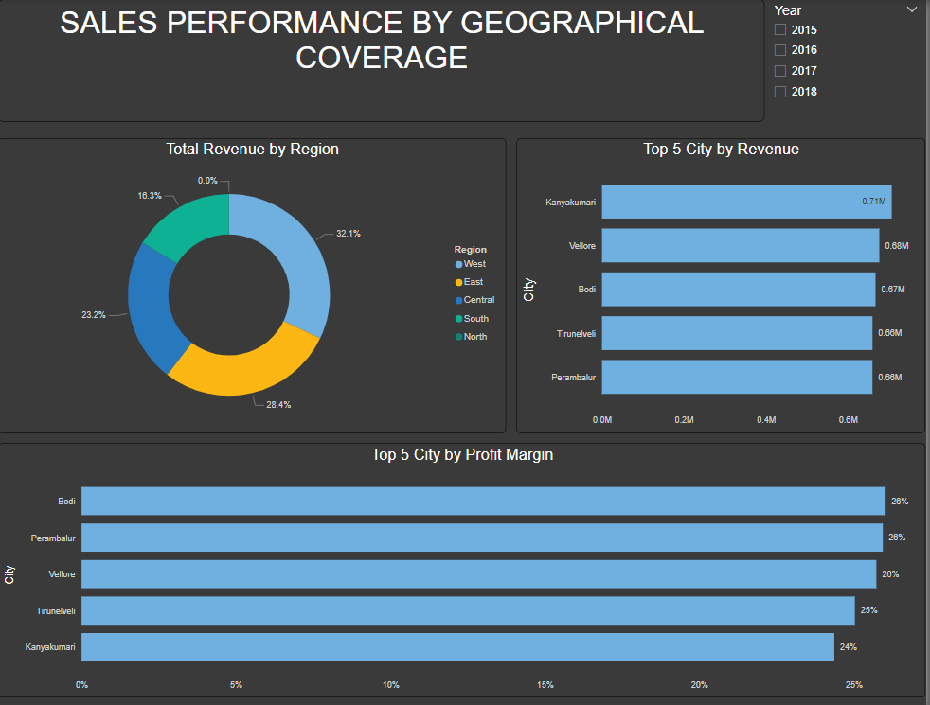
Insights Summary:
The West leads in revenue (32.1%), while North (0%) remains untapped, and South underperforms, needing strategic improvements.
Kanyakumari leads with 0.71M in revenue, while others contribute 0.68M, indicating a balanced market and an opportunity to grow revenue by targeting expanding cities.
Bodi, Perambalur, and Vellore have the highest profit margins (28%), while Kanyakumari (24%) needs cost optimization, highlighting the need for margin-improving strategies in weaker cities.
Recommendations for Growth
Conduct market research to identify demand, expand distribution channels, and use targeted campaigns to drive awareness and adoption.
Increase sales and marketing in Kanyakumari, Vellore, and Bodi, implement loyalty programs and promotions for repeat customers, and enhance customer experience to boost retention and referrals.
Reduce operational costs, renegotiate supplier contracts for better pricing, and implement dynamic pricing to optimize margins.

Slide 5
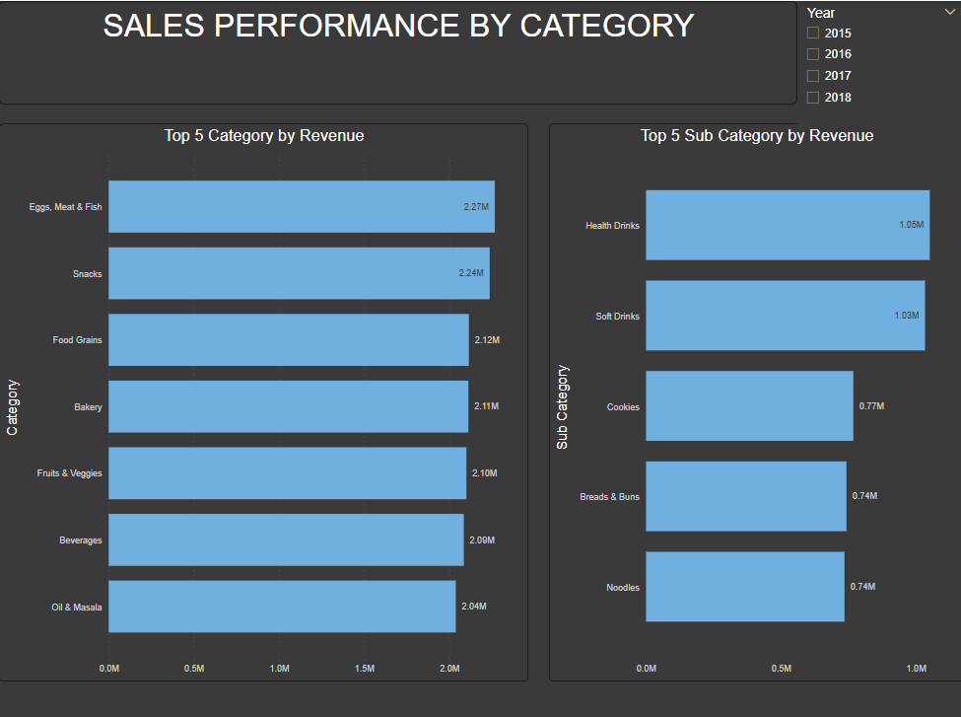
reduce a sentence
ChatGPT said:
Health Drinks (1.05M) and Soft Drinks (1.03M) lead, while other subcategories contribute moderately.
Insights Summary:
Eggs, Meat & Fish (2.27M) and Snacks (2.24M) generate the highest revenue, with other categories performing slightly lower.
Health Drinks (1.05M) and Soft Drinks (1.03M) lead, while other subcategories contribute moderately.
Revenue is well-balanced across categories, with no extreme gaps.
Beverages and Oil & Masala have lower revenue than the top-performing categories, indicating room for growth.
Recommendations for Growth:
Focus on expanding sales and promotions in Eggs, Meat & Fish, and Snacks to maximize revenue.
Enhance marketing for Cookies, Breads & Buns, and Noodles while offering discounts and new or healthier flavors to boost sales.
Strong performance in Health and Soft Drinks suggests expanding beverages with targeted marketing for energy drinks, flavored waters, or organic options.
reduce a sentence
ChatGPT said:
Health Drinks (1.05M) and Soft Drinks (1.03M) lead, while other subcategories contribute moderately.

Slide 6
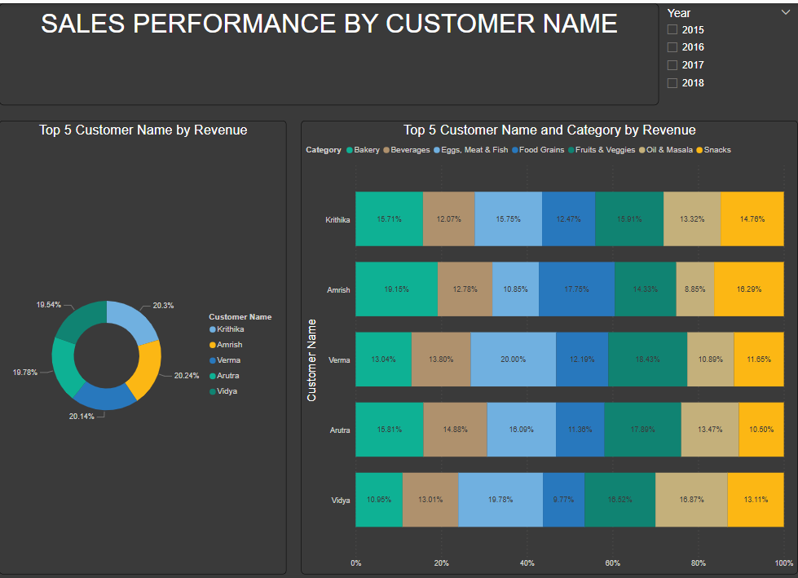
Insights Summary:
Krithika (20.3%) is the top revenue-generating customer, with a balanced revenue distribution across the customer base.
Verma prefers Eggs, Meat & Fish (20%), Arutra leads in Fruits & Veggies (17.8%), Vidya favors Snacks (18.87%), while Krithika and Amrish have balanced preferences.
No single customer dominates all categories, indicating diverse purchasing habits, with Snacks, Fruits & Veggies, and Eggs, Meat & Fish as key revenue drivers.
Recommendations
Offer personalized promotions and loyalty programs to encourage repeat purchases and increase retention.
Promote category-specific discounts to Verma, Arutra, and Vidya while using cross-selling strategies to balance purchases.
Identify high-value customers with similar buying patterns and use referral incentives to attract new customers.

Slide 7

THANK YOU
Ashiat Adeogun
ashiatadeogun01@gmail.com
https://www.linkedin.com/in/ash-ad/
https://github.com/asiat2

